Slide 1


Data-Driven Storytelling Presentation
Driving Growth at JP Morgan & Chase
By Shiv Mohan Lanka

Slide 2

A 5-Year Journey of Growth
Introducing consistent growth in sales over time based on CGAR
(51.77% on AVG)

Slide 3
Introduction
Problem Statement
J.P. Morgan Chase & Co. is a prominent global financial services firm providing a wide range of services and operating internationally.
The company seeks to evaluate the account performance metrics over the past 5 years(2017-2021) and identify the factors contributing to the compound annual growth rate (CGAR) in unit sales.
Business Questions:
Reviewing the overall unit sales for each year.
Determining which account types are outperforming others in terms of unit sales.
Calculating the average compound annual growth rate(CGAR) for various account types.
Identifying the top-performing accounts.

Slide 4
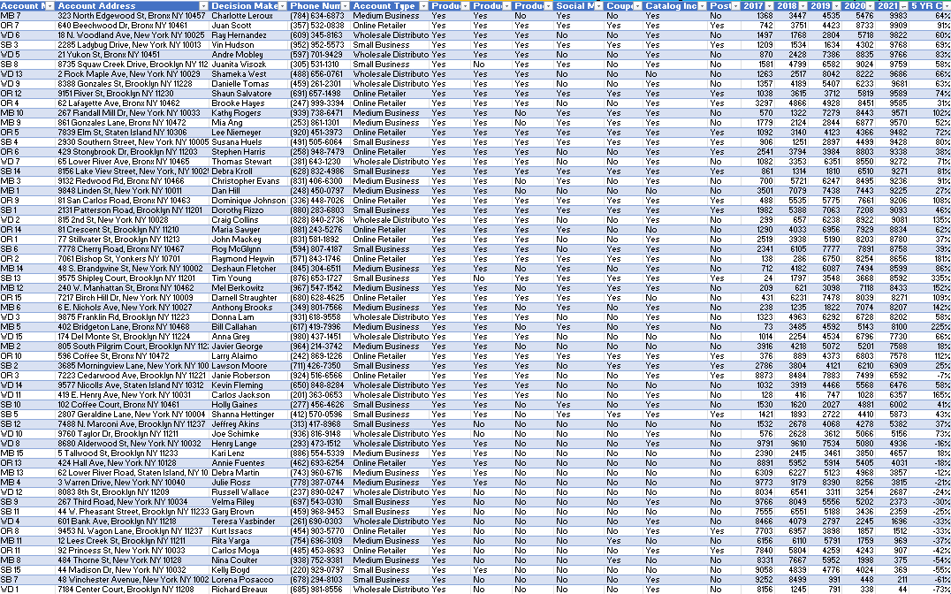
Data Modelling
Using power Query in MS Excel to clean and transform the data into the required format

Slide 5
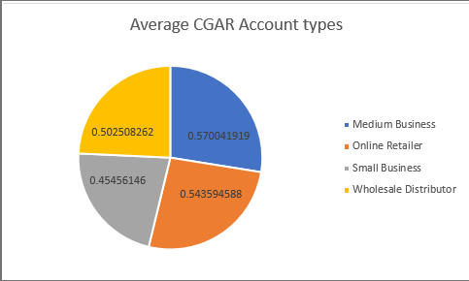
Data Analysis
CGAR Vs Account Types
Medium businesses have the highest CGAR(57.2%)

Slide 6
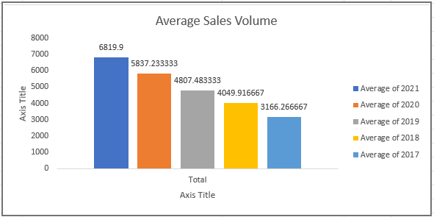
Data Analysis
Average Sales Volume Vs Year
The Average Sales volume in 2021 is highest from 2017 to 2021

Slide 7
Summary
Despite the great performance, there is still room for improvement.
Discontinuing poorly performing Accounts would free up there marketing resources.
Again, These five years have shown a robust sales growth.
By reallocating the resources saved from closing underperforming accounts to online retailer accounts, sales growth could be maximized.
Give any incentives to top customers so that more business could be attracted.

